Slide 1
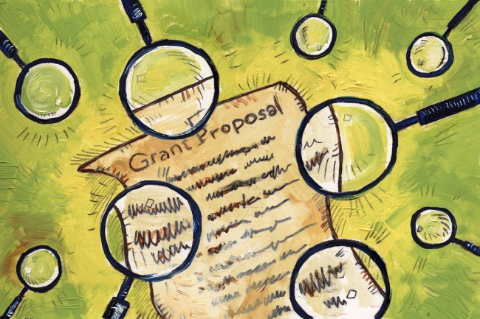
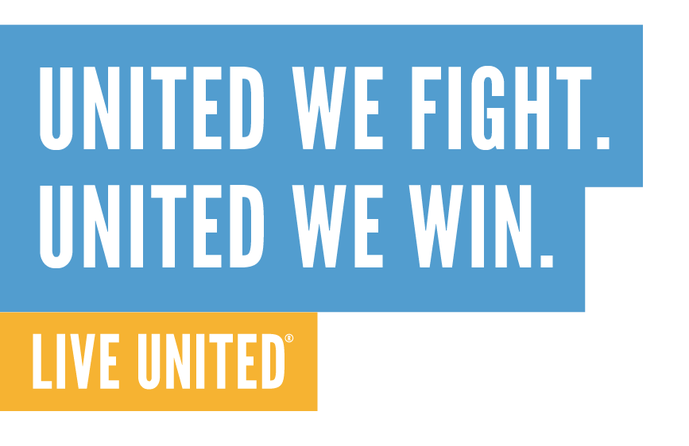
Planning & Writing Strong Grant Applications
March 6, 2019

Slide 2
Agenda
Learning goals for today & introductions
Pre-proposal tips
Crafting a strong narrative & activity
Finalizing the proposal
Submittal tips
How to handle success & rejection
What questions remain?

Slide 3
Before we begin…
All slides will be posted on the MUW website within one week of this training. (www.muw.org/community-partner-resources)
The last slide includes active links to sample grant tips resources; download the slides and click the links to access those websites.
Budget is an important part of any grant application; however, we won’t be covering that in this session
More weight is generally assigned to the strength of the narrative application as opposed to the budget
For additional support beyond this training, contact Jill at jill@muw.org or 603-352-4209, ext 29.

Slide 4
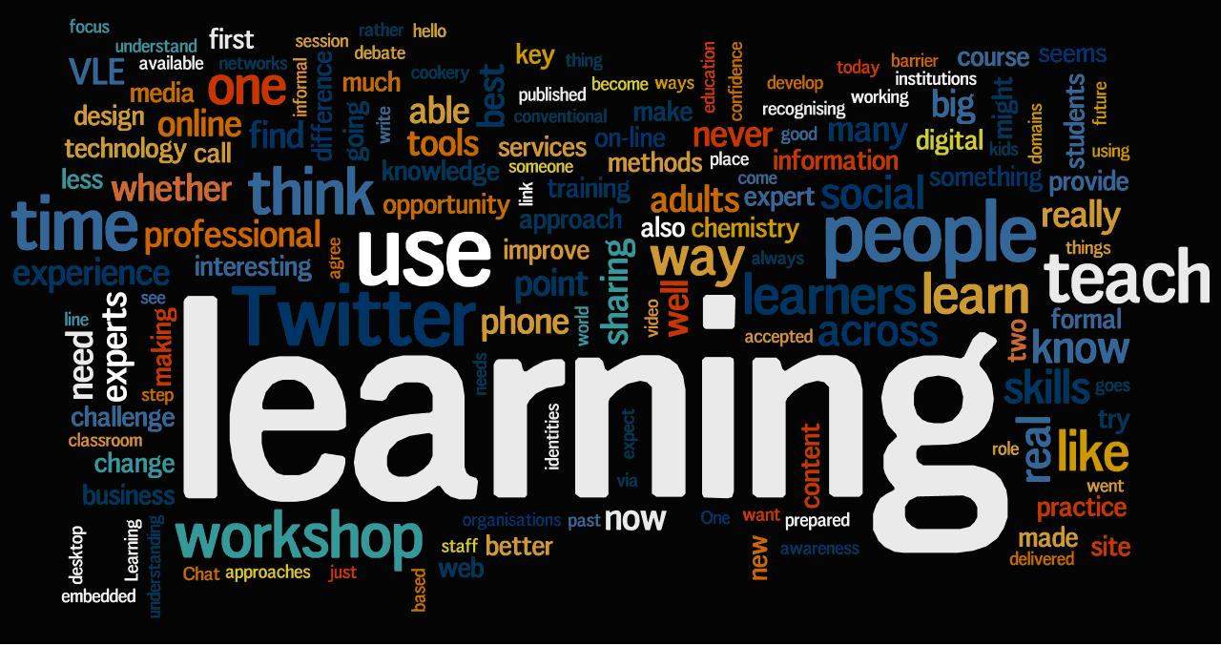
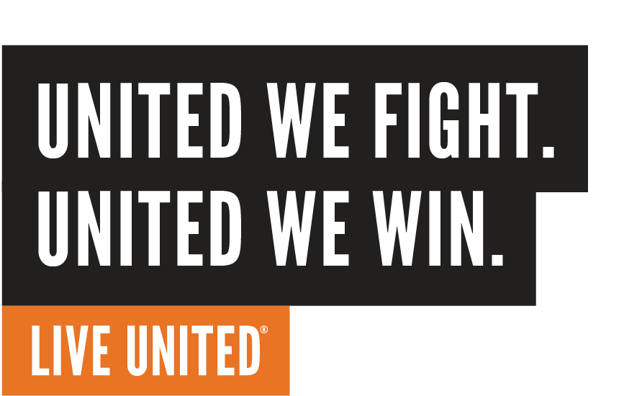
What is your personal learning goal for today?
Notes:
To ensure that the UNITED WE FIGHT. UNITED WE WIN. Artwork is on top of the photo you may have to click on photo box and select to SEND TO BACK.

Slide 5
Personal Learning Goals
Be a sponge; learn how to better support agencies applying for MUW funding
Deepen understanding of grant preparation and build grant-writing skills
Learn strategies & skills to write the strongest grant possible!
Glean ideas to feel more competent around grants
Absorb everything! Add skills to professional repertoire
Learn how to present outcomes & performance measures as part of grant application
Better understand how to demonstrate alignment in proposal
Bring content back to staff at agency
Learn how to be more efficient in preparing grant proposals
Reduce intimidation around communicating performance measures/results
Learn how to express program success & value so it stands out in a proposal
Already a grant reviewer; looking to build skills as a grantwriter
Better understand what it takes to write a strong proposal
Learn what turns off grant reviewers

Slide 6
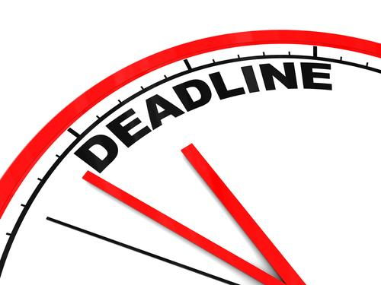
Pre-Proposal Tips
Research and contact funder
Awards from past funding cycles
Ensure project alignment with funder priorities
Ask questions & develop positive relationship
Develop a timeline and plan of action steps with a goal to submit EARLY!
Schedule meetings with key players well in advance
Project/program partners
Finance/budget team
Outside individuals to review draft(s)
Others
Notes:
Preview next slide by asking who attended the Logic Models training on 1/31…Have some folks share what they remember about them and say yes, they’re very important for a strong grant proposal.

Slide 7
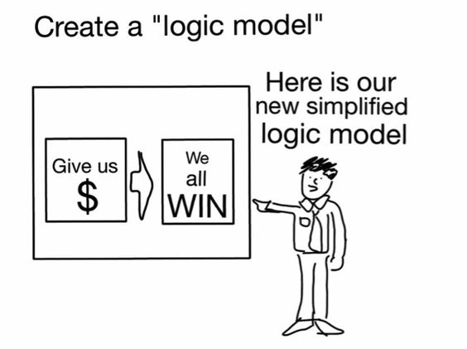

Slide 8
Crafting a Strong Narrative - Essentials
Statement of Need
What is the problem you’re addressing? How do you know it’s a problem?
Clear Statement of Expected Results**
Logic Model
Performance Measures
Solid Action Plan – Methods & Approach
Why – evidence that your approach works
4 Ws + 1 H = Who, What, When, Where, How
**See presentation PPTs from Logic Models and Performance Measures workshops on MUW website: https://www.muw.org/community-partner-resources
Notes:
The word “crafting” is intentionally used
I could spend an entire day training to crafting a strong narrative – what you’re getting is only touching the surface
Refer to handout for a bit more detailed information
DATA is an essential component of articulating the problem
Remember you can contact me or Nikki with help in this area prior to release of the RFP

Slide 9
Crafting a Strong Narrative - Essentials
Evaluation Plan
What is your process to measure outcomes?
How will you monitor to ensure you’re on track?
What will you do if you’re off track?
Sustainability Plan
Give it thought
Leveraged $$
Don’t forget in-kind resources
Notes:
Solicit examples of In-kind resources: volunteers; donated space, materials, furniture, equipment, etc.

Slide 10
Crafting a Strong Narrative - Essentials
Other considerations to include in a Sustainability Plan:
Staffing/leadership
Client participation
Program location/space
Collaborations
Advocacy
Notes:
Brainstorm how each contributes to sustainability

Slide 11
Crafting a Strong Narrative - What Not To Do
Just cut and paste from previous proposals
Include jargon and technical language
“We hope to…”
Have overly ambitious plans and outcome statements
Neglect to answer all parts of each application question

Slide 12
Crafting a Strong Narrative – Making Reviewers Happy
Be realistic – what can you really, truly accomplish?
Write as though you are getting the grant (“We will…”)
Write to fully answer the question before editing to word or character limits
BE CONCISE!

Slide 13
Activity:
Cutting Words & Restructuring Sentences for Brevity

Slide 14
Finalizing the Proposal – Making Reviewers Happy
NOT THIS…
BUT THIS!

Slide 15
Finalizing the Proposal – Making Reviewers Happy
Have “outsiders” read for understanding and clarity
Technical details
Spelling, grammar & consistent capitalization count!
Have you accurately referenced supporting documents in the narrative? Are all attachments actually attached?
Example: See Attachment A
For paper applications: Is the formatting attractive, consistent, and readable? Do references to attachments include page numbers?
Clearly align project/program activities with budget

Slide 16
Finalizing the Proposal – What’s Wrong Here?
The PMC was founded in response to a demand for training regarding statewide implementation of the PM after federal funding ended for CSEFEL, which developed the PM for PSECIYC, and TACSEI. The PMC consists of 15 founding members of CSEFEL, TACSEI and the PM, who represent seven universities across the U.S. Its mission is to promote the high fidelity use of the PM at state and local levels.

Slide 17
Finalizing the Proposal – Acronym Rules
For online applications: Spell out the first time it appears in each response, then put the acronym in parentheses.
Example: The Pyramid Model Consortium (PMC) was founded in response to a demand for training. The PMC consists of 15 founding members who represent seven universities.
For paper applications: Spell out the first time it appears on each page of the printed proposal.

Slide 18
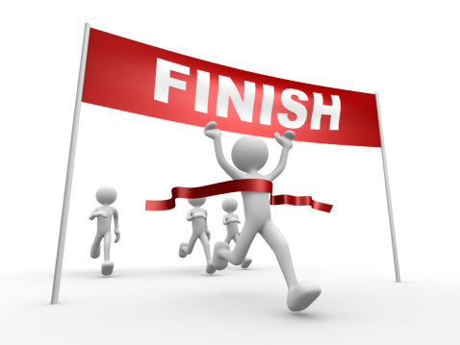
Submitting the Proposal – You’re at the Finish Line!
For online applications, always copy responses into a Word document for backup
Use a checklist to make sure you’ve provided all requested items
Use the funder’s checklist or make your own
Examples: Supporting documents, number of copies (for paper submittals)
Check, double-check, and triple check!
Make sure you are sharing the most current organizational documents (990s, etc.)

Slide 19
Next Steps – Awarded!
Be sure to send a thank you letter!
Submit all required reports before or by deadline
Keep the funder informed of any and all changes to your project/program
Staffing, budget, activities, etc.

Slide 20
Next Steps - Rejection
Contact the funder and ask for feedback on your application
What were their reasons for not funding your proposal?
What could you have done differently?
Some funders will share reviewer feedback with applicants, some won’t
Rule of thumb: If you’ve been rejected three times by the same funder, throw in the towel and move on.

Slide 21
Check-in on personal learning goals – what questions remain?
Notes:
Refer back to personal learning goals

Slide 22
Don’t forget to complete your workshop evaluation form!

Slide 23
Grant Tips – Sample Resources
https://www.tgci.com/getting-grant-101
https://www.dhleonardconsulting.com/5-things-not-to-say-in-grant-applications/
https://www.thebalancesmb.com/what-not-to-do-grant-proposals-2501981

